Slide 1
Lecture 2.2—Introduction to Feedforward neural networks

Slide 2
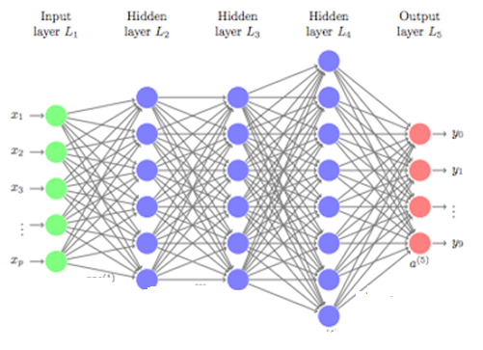
Feedforward neural network
Feedforward neural are the simplest form of deep neural networks.
Feedforward neural networks consists of several layers of computational units (called neuron).
A neuron forms the basic building block of all types of deep neural networks
It is called feedforward because each neuron in a layer sends its output to some or all of the neurons in its subsequent layer.
The first layer, is called the input layer where the network receives the training data.
The network consists of several hidden layers where each layer learns a higher level of representation from the data
Finally the last layer is called the output layer where the network produces its output.
A feedforward neural network is sometimes referred to as multi-layer Perceptron (MLP) if every neuron in each layer is connected to all neurons in its subsequent layer
A neuron

Slide 3
What is a neuron

Slide 4




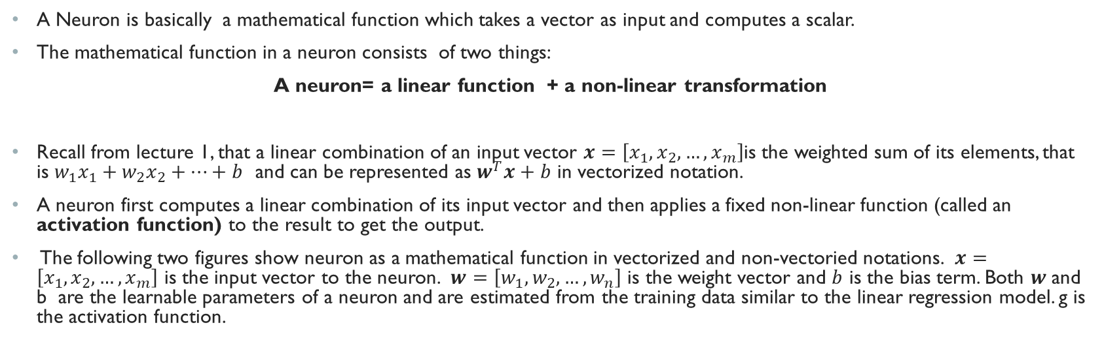


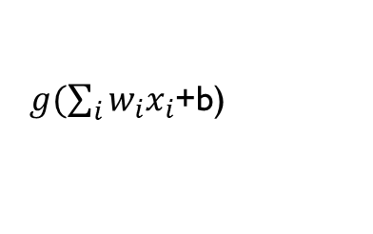



What is a neuron?
A Neuron is basically a mathematical function which takes a vector as input and computes a scalar.
The mathematical function in a neuron consists of two things:
A neuron= a linear function + a non-linear transformation
Recall from lecture 1, that a linear combination of an input vector $x=\left[x_{1},x_{2}, …,x_{m}\right]$is the weighted sum of its elements, that is $w_{1}x_{1}+w_{2}x_{2}+…+b$ and can be represented as $w^{T}x+b$ in vectorized notation.
A neuron first computes a linear combination of its input vector and then applies a fixed non-linear function (called an activation function) to the result to get the output.
The following two figures show neuron as a mathematical function in vectorized and non-vectoried notations. $x=\left[x_{1},x_{2}, …,x_{m}\right]$ is the input vector to the neuron. $w=\left[w_{1},w_{2},…,w_{n}\right]$ is the weight vector and $b$ is the bias term. Both $w$and b are the learnable parameters of a neuron and are estimated from the training data similar to the linear regression model. g is the activation function.
$$x_{1}$$
$g(\sum_{i}{{w_{i}x}_{i}}$+b)
$$x$$
$g(w^{T}x$+b)
$$x_{2}$$
$$<w_{1},w_{2}, …,w_{m},b>$$
$$<w,b>$$
$$x_{3}$$
$$⋮$$
A neuron in non-vectorized notation
A neuron in vectorized notation
$$x_{m}$$

Slide 5
Why do we need an activation function?
The only difference between a neuron and a linear regression unit is that a neuron includes a fixed activation function.
Without any activation function, a single neuron corresponds to a simple linear regression model we studied in lecture 1.
The purpose of activation function is to add non-linearity to the function that a neuron computes and allows neural networks to model complex non-linear relationship between the input and the output.
Without an activation function, a neural network would be nothing other than a chain/stack of linear functions applied to the input resulting in the entire network to be just a linear mapping from the input to the output (that is, no better than a linear regression)
Activation functions are elementwise non-linear functions. By elementwise we mean that the function is applied to each element of its input ( vector or matrix) returning an output with the same dimension as input
The most commonly used activation functions are :
Relu
Sigmoid
Tanh
softmax

Slide 6
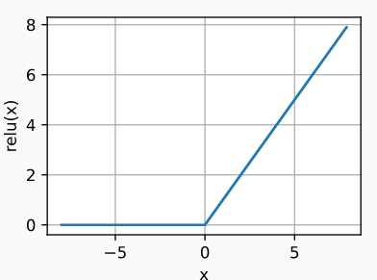



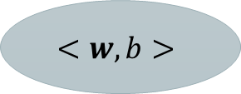
RELU Activation Function
The most popular activation function, due to its simplicity of implementation and performance on a variety of tasks, is the Rectified Linear Unit (RELU).
Relu is typically the most popular choice for the activation function of the neurons in the hidden layers.
Relu provides a very simple non-linear transformation: given the element $z$, relu returns maximum of that element and zero:
$$relu\left(z\right)=\max\left(z,0\right)$$
This means that relu function only retains the positive elements and discards the negative elements ( set their activations to zero)
The reason for using the ReLU is that its derivatives are particularly well behaved
The derivative is zero when z<0 and is one when z>0
This makes the optimization algorithm for estimating the weights of neuron better behaved and helps mitigate the problem of vanishing gradient in deeper networks which plagued previous versions of neural networks ( more on the vanishing gradients in a later module)
$$x$$
$$\max\left(w^{T}x+b\right),0)$$
$$<w,b>$$
A neuron with relu activation

Slide 7
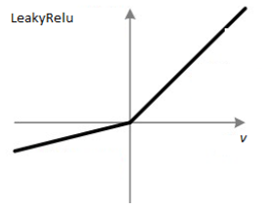
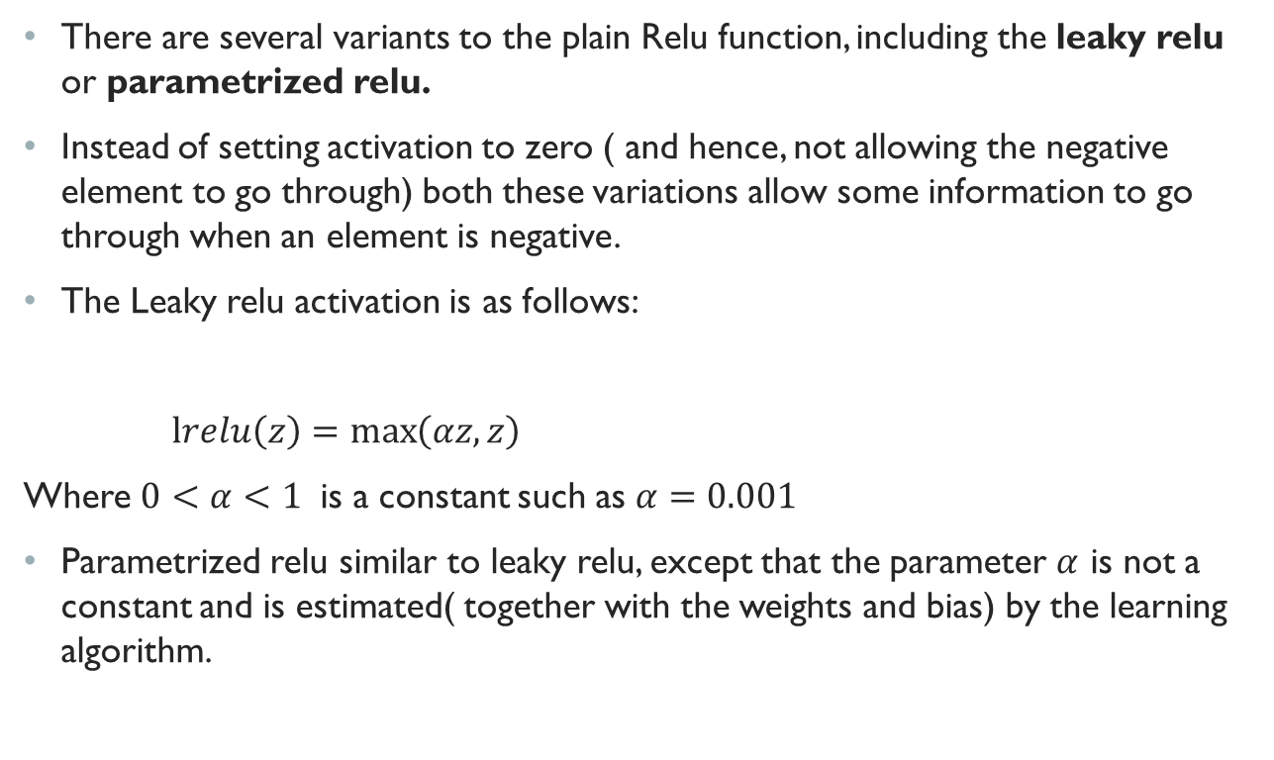


Some Variants of Relu
There are several variants to the plain Relu function, including the leaky relu or parametrized relu.
Instead of setting activation to zero ( and hence, not allowing the negative element to go through) both these variations allow some information to go through when an element is negative.
The Leaky relu activation is as follows:
$lrelu\left(z\right)=\max\left(αz,z\right)$
Where $0<α<1$ is a constant such as $α=0.001$
Parametrized relu similar to leaky relu, except that the parameter $α$ is not a constant and is estimated( together with the weights and bias) by the learning algorithm.
$$relu=z$$
$$relu=αz$$

Slide 8
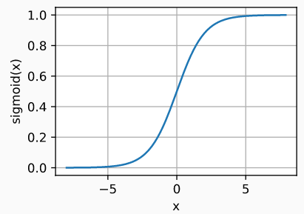
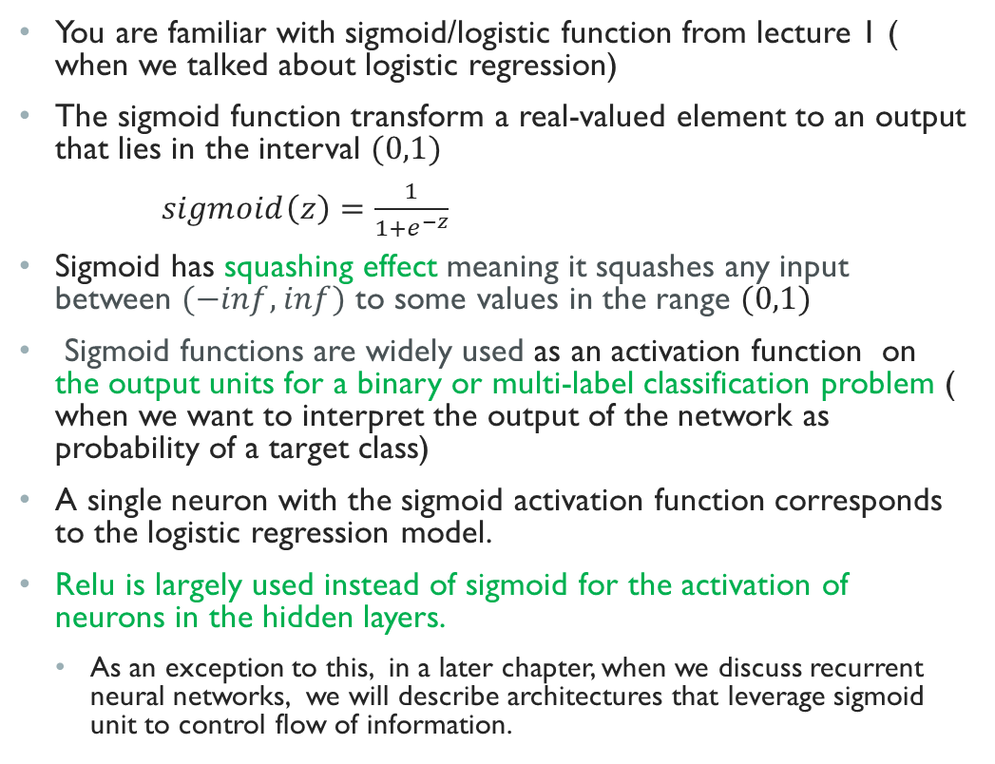

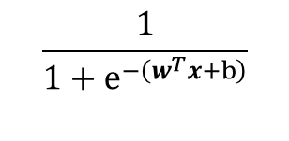
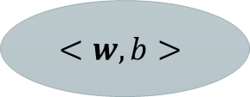
Sigmoid/logistic Activation
$$\frac{1}{1+e^{−\left(w^{T}x+b\right)}}$$
$$x$$
$$<w,b>$$
You are familiar with sigmoid/logistic function from lecture 1 ( when we talked about logistic regression)
The sigmoid function transform a real-valued element to an output that lies in the interval $(0,1)$
$sigmoid\left(z\right)=\frac{1}{1+e^{−z}}$
Sigmoid has squashing effect meaning it squashes any input between $(−inf,inf)$ to some values in the range $(0,1)$
Sigmoid functions are widely used as an activation function on the output units for a binary or multi-label classification problem ( when we want to interpret the output of the network as probability of a target class)
A single neuron with the sigmoid activation function corresponds to the logistic regression model.
Relu is largely used instead of sigmoid for the activation of neurons in the hidden layers.
As an exception to this, in a later chapter, when we discuss recurrent neural networks, we will describe architectures that leverage sigmoid unit to control flow of information.
A single neuron with sigmoid activation
corresponds to the logistic regression model
Notes:
In the earliest neural networks, scientists were interested in modeling biological neurons which either fire or do not fire. Thus the pioneers of this field, going all the way back to McCulloch and Pitts, the inventors of the artificial neuron, focused on thresholding units. A thresholding activation takes value 00 when its input is below some threshold and value 11 when the input exceeds the threshold.
When attention shifted to gradient based learning, the sigmoid function was a natural choice because it is a smooth, differentiable approximation to a thresholding unit.

Slide 9
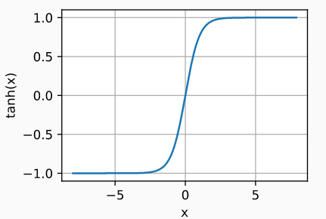
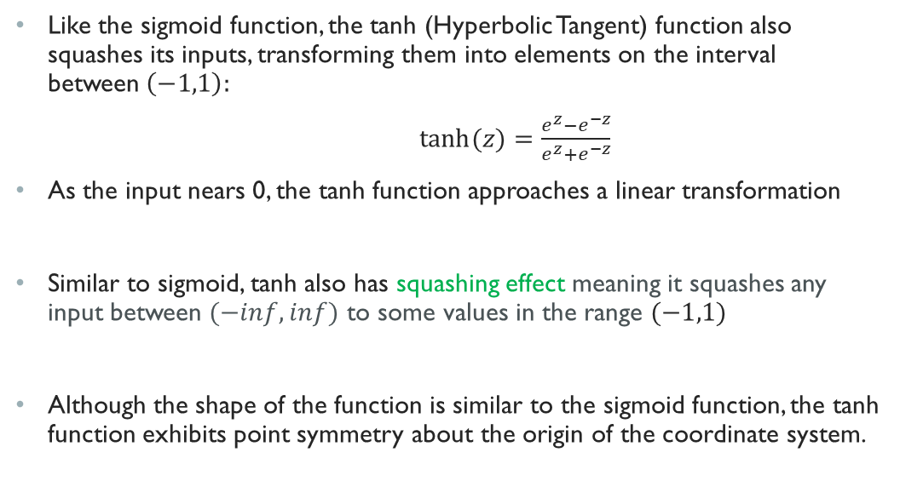

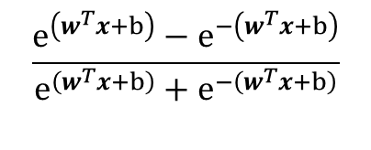

Tanh Activation
$$\frac{e^{\left(w^{T}x+b\right)}−e^{−\left(w^{T}x+b\right)}}{e^{\left(w^{T}x+b\right)}+e^{−\left(w^{T}x+b\right)}}$$
Like the sigmoid function, the tanh (Hyperbolic Tangent) function also squashes its inputs, transforming them into elements on the interval between$\left(−1,1\right):$
$\tanh{(z)}=\frac{e^{z}−e^{−z}}{e^{z}+e^{−z}}$
As the input nears 0, the tanh function approaches a linear transformation
Similar to sigmoid, tanh also has squashing effect meaning it squashes any input between $(−inf,inf)$ to some values in the range $(−1,1)$
Although the shape of the function is similar to the sigmoid function, the tanh function exhibits point symmetry about the origin of the coordinate system.
$$x$$
$$<w,b>$$
A neuron with tanh activation

Slide 10
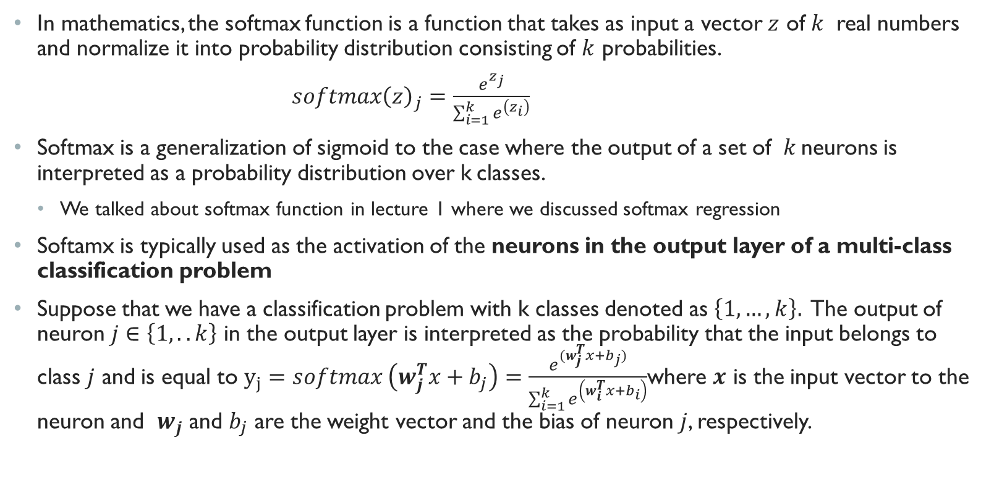
Softmax Activation
In mathematics, the softmax function is a function that takes as input a vector $z$ of $k$ real numbers and normalize it into probability distribution consisting of $k$ probabilities.
$softmax{\left(z\right)}_{j}=\frac{e^{z_{j}}}{\sum_{i=1}^{k}{e^{\left(z_{i}\right)}}}$
Softmax is a generalization of sigmoid to the case where the output of a set of $k$neurons is interpreted as a probability distribution over k classes.
We talked about softmax function in lecture 1 where we discussed softmax regression
Softamx is typically used as the activation of the neurons in the output layer of a multi-class classification problem
Suppose that we have a classification problem with k classes denoted as $\left\{1,…,k\right\}.$ The output of neuron $j∈\left\{1,..k\right\}$ in the output layer is interpreted as the probability that the input belongs to class $j$ and is equal to $y_{j}=softmax \left(w_{j}^{T}x+b_{j}\right)=\frac{e^{(w_{j}^{T}x+b_{j})}}{\sum_{i=1}^{k}{e^{\left(w_{i}^{T}x+b_{i}\right)}}}$where $x$ is the input vector to the neuron and $w_{j}$ and $b_{j}$ are the weight vector and the bias of neuron $j$, respectively.

Slide 11
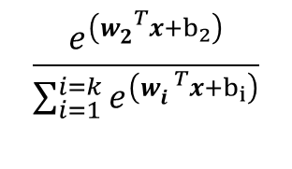
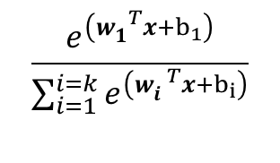

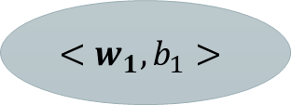
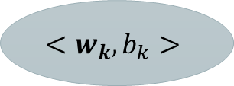
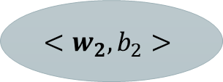

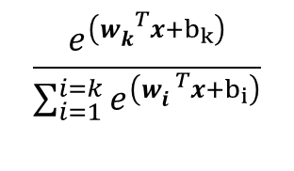
Softmax activation (Cont.)
$$\frac{e^{\left(w_{1}^{ T}x+b_{1}\right)}}{\sum_{i=1}^{i=k}{e^{\left(w_{i}^{ T}x+b_{i}\right)}}}$$
K neurons with softmax activation corresponds to a softmax regression model for classifying an input into k classes
Each neuron has its own weight vector and bias parameters learned from the training data.
The output of the neurons represent a probability distribution and add up to 1.
$$<w_{1},b_{1}>$$
$$x$$
$$\frac{e^{\left(w_{2}^{ T}x+b_{2}\right)}}{\sum_{i=1}^{i=k}{e^{\left(w_{i}^{ T}x+b_{i}\right)}}}$$
$$<w_{2},b_{2}>$$
$$⋮$$
$$\frac{e^{\left(w_{k}^{ T}x+b_{k}\right)}}{\sum_{i=1}^{i=k}{e^{\left(w_{i}^{ T}x+b_{i}\right)}}}$$
$$<w_{k},b_{k}>$$

Slide 12
Computing the output of a feedforward neural network

Slide 13
How does neural network compute its output
This is how a feedforward neural network compute its output.
The network gets an input vector in the input layer.
The hidden neurons in the first layer, each receive this input vector and compute their output using their weight vector and their bias parameters.
The outputs of the neurons in the firs hidden layer form a vector and pass it on as input to the neurons in the second hidden layer.
The neurons in the second hidden layer compute their outputs and pass it on as input to the neurons in the third hidden layer and so on until the output layer . The outputs of the neurons in the final output layer form the final output of the neural network.

Slide 14





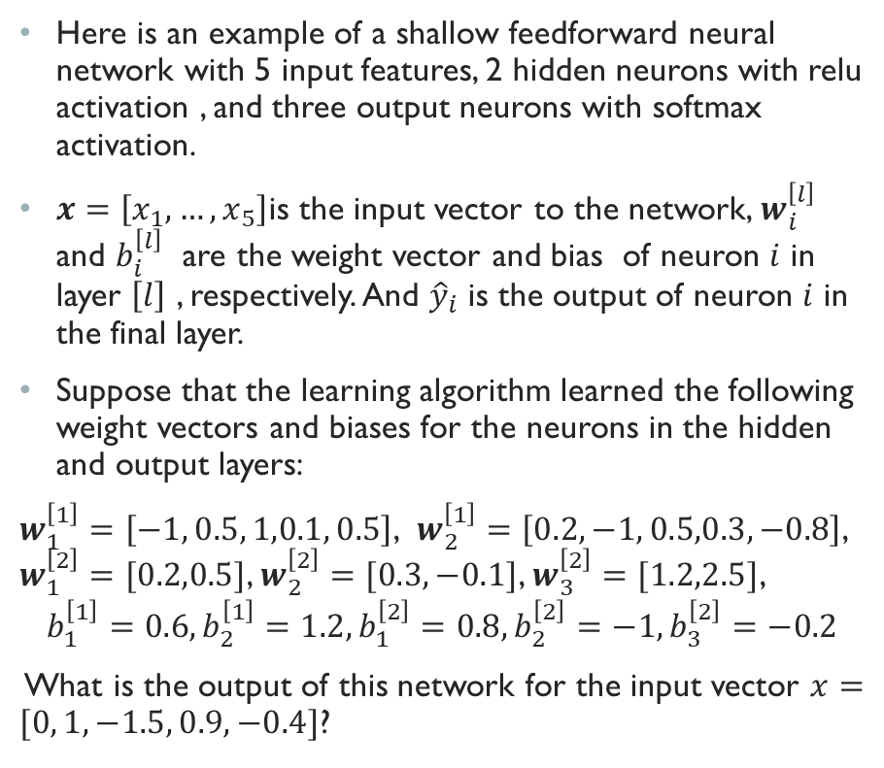








Example of a feedforward neural network
Here is an example of a shallow feedforward neural network with 5 input features, 2 hidden neurons with relu activation , and three output neurons with softmax activation.
$x=\left[x_{1},…,x_{5}\right]$is the input vector to the network, $w_{i}^{\left[l\right]}$ and $b_{i}^{\left[l\right]}$ are the weight vector and bias of neuron $i$ in layer $\left[l\right]$ , respectively. And ${\hat{y}}_{i}$ is the output of neuron $i$ in the final layer.
Suppose that the learning algorithm learned the following weight vectors and biases for the neurons in the hidden and output layers:
$w_{1}^{\left[1\right]}=\left[−1, 0.5, 1,0.1, 0.5\right]$, $w_{2}^{\left[1\right]}=\left[0.2, −1, 0.5,0.3, −0.8\right]$, $w_{1}^{\left[2\right]}=[0.2,0.5]$, $w_{2}^{\left[2\right]}=[0.3,−0.1]$, $w_{3}^{\left[2\right]}=[1.2,2.5]$,
$$b_{1}^{\left[1\right]}=0.6, b_{2}^{\left[1\right]}=1.2, b_{1}^{\left[2\right]}=0.8,b_{2}^{\left[2\right]}=−1, b_{3}^{\left[2\right]}=−0.2$$
What is the output of this network for the input vector $x=[0, 1,−1.5, 0.9, −0.4]$?
$$x_{1}$$
$${\hat{y}}_{1}$$
$$<w_{1}^{\left[2\right]},b_{1}^{[2]}>$$
$$x_{2}$$
$$<w_{1}^{\left[1\right]},b_{1}^{[1]}>$$
$$<w_{2}^{\left[2\right]},b_{2}^{[2]}>$$
$${\hat{y}}_{2}$$
$$x_{3}$$
$$<w_{2}^{\left[1\right]},b_{2}^{[1]}>$$
$$x_{4}$$
$$<w_{3}^{\left[2\right]},b_{3}^{[2]}>$$
$${\hat{y}}_{3}$$
$$x_{5}$$

Slide 15

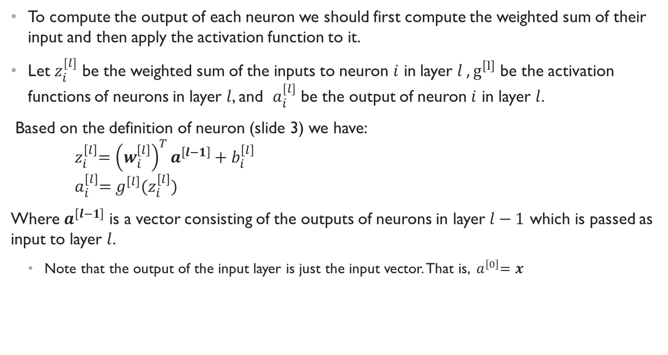



Some Notations
To compute the output of each neuron we should first compute the weighted sum of their input and then apply the activation function to it.
Let $z_{i}^{[l]}$ be the weighted sum of the inputs to neuron $i$ in layer $l , g^{\left[l\right]}$ be the activation functions of neurons in layer $l$, and $a_{i}^{[l]}$ be the output of neuron $i$ in layer $l$.
Based on the definition of neuron (slide 3) we have:
$${ z}_{i}^{\left[l\right]}={\left(w_{i}^{\left[l\right]}\right)}^{T}a^{\left[l−1\right]}+b_{i}^{\left[l\right]}$$
$${ a}_{i}^{\left[l\right]}=g^{\left[l\right]}(z_{i}^{\left[l\right]})$$
Where $a^{\left[l−1\right]}$ is a vector consisting of the outputs of neurons in layer $l−1$ which is passed as input to layer $l$.
Note that the output of the input layer is just the input vector. That is, ${ a}^{\left[0\right]}=x$
$$a^{\left[l−1\right]}$$
$$<w_{i}^{\left[l\right]},b_{i}^{\left[l\right]}>$$
$$z_{i}^{\left[l\right]}={w_{i}^{\left[l\right]}}^{T}a^{\left[l−1\right]}+b_{i}^{\left[l\right]}$$
$$a_{i}^{\left[l\right]}=g^{\left[l\right]}(z_{i}^{\left[l\right]})$$

Slide 16
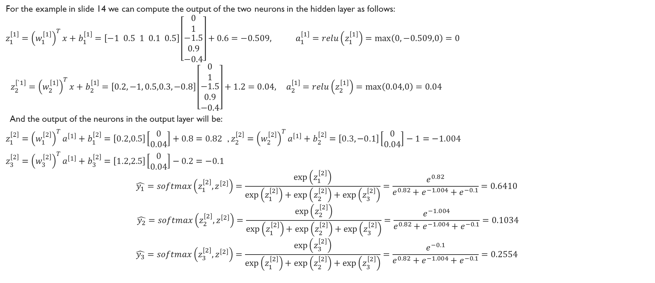
Example of a feedforward neural network (cont.)
For the example in slide 14 we can compute the output of the two neurons in the hidden layer as follows:
$$z_{1}^{\left[1\right]}={\left(w_{1}^{\left[1\right]}\right)}^{T}x+b_{1}^{\left[1\right]}=\left[−1 0.5 1 0.1 0.5\right]\left[\begin{matrix}0 \\ 1 \\ \begin{aligned}−1.5 \\ 0.9 \\ −0.4\end{aligned}\end{matrix}\right]+0.6=−0.509, a_{1}^{\left[1\right]}=relu\left(z_{1}^{\left[1\right]}\right)=\max\left(0,−0.509,0\right)=0$$
$z_{2}^{\left[`1\right]}={\left(w_{2}^{\left[1\right]}\right)}^{T}x+b_{2}^{\left[1\right]}=\left[0.2, −1, 0.5,0.3, −0.8\right]\left[\begin{matrix}0 \\ 1 \\ \begin{aligned}−1.5 \\ 0.9 \\ −0.4\end{aligned}\end{matrix}\right]+1.2=0.04, { a}_{2}^{\left[1\right]}=relu\left(z_{2}^{\left[1\right]}\right)=\max\left(0.04,0\right)=0.04$
And the output of the neurons in the output layer will be:
$z_{1}^{\left[2\right]}={\left(w_{1}^{\left[2\right]}\right)}^{T}a^{\left[1\right]}+b_{1}^{\left[2\right]}=\left[0.2,0.5\right]\left[\begin{aligned}0 \\ 0.04\end{aligned}\right]+0.8=0.82$ , $z_{2}^{\left[2\right]}={\left(w_{2}^{\left[2\right]}\right)}^{T}a^{\left[1\right]}+b_{2}^{\left[2\right]}=\left[0.3,−0.1\right]\left[\begin{aligned}0 \\ 0.04\end{aligned}\right]−1=−1.004$
$z_{3}^{\left[2\right]}={\left(w_{3}^{\left[2\right]}\right)}^{T}a^{\left[1\right]}+b_{3}^{\left[2\right]}=\left[1.2,2.5\right]\left[\begin{aligned}0 \\ 0.04\end{aligned}\right]−0.2=−0.1$
$$\hat{y_{1}}=softmax\left(z_{1}^{\left[2\right]}, z^{\left[2\right]}\right)=\frac{\exp\left(z_{1}^{\left[2\right]}\right)}{\exp\left(z_{1}^{\left[2\right]}\right)+\exp\left(z_{2}^{\left[2\right]}\right)+\exp\left(z_{3}^{\left[2\right]}\right)}=\frac{e^{0.82}}{e^{0.82}+e^{−1.004}+e^{−0.1}}=0.6410$$
$$\hat{y_{2}}=softmax\left(z_{2}^{\left[2\right]}, z^{\left[2\right]}\right)=\frac{\exp\left(z_{2}^{\left[2\right]}\right)}{\exp\left(z_{1}^{\left[2\right]}\right)+\exp\left(z_{2}^{\left[2\right]}\right)+\exp\left(z_{3}^{\left[2\right]}\right)}=\frac{e^{−1.004}}{e^{0.82}+e^{−1.004}+e^{−0.1}}=0.1034$$
$$\hat{y_{3}}=softmax\left(z_{3}^{\left[2\right]}, z^{\left[2\right]}\right)=\frac{\exp\left(z_{3}^{\left[2\right]}\right)}{\exp\left(z_{1}^{\left[2\right]}\right)+\exp\left(z_{2}^{\left[2\right]}\right)+\exp\left(z_{3}^{\left[2\right]}\right)}=\frac{e^{−0.1}}{e^{0.82}+e^{−1.004}+e^{−0.1}}=0.2554$$

Slide 17
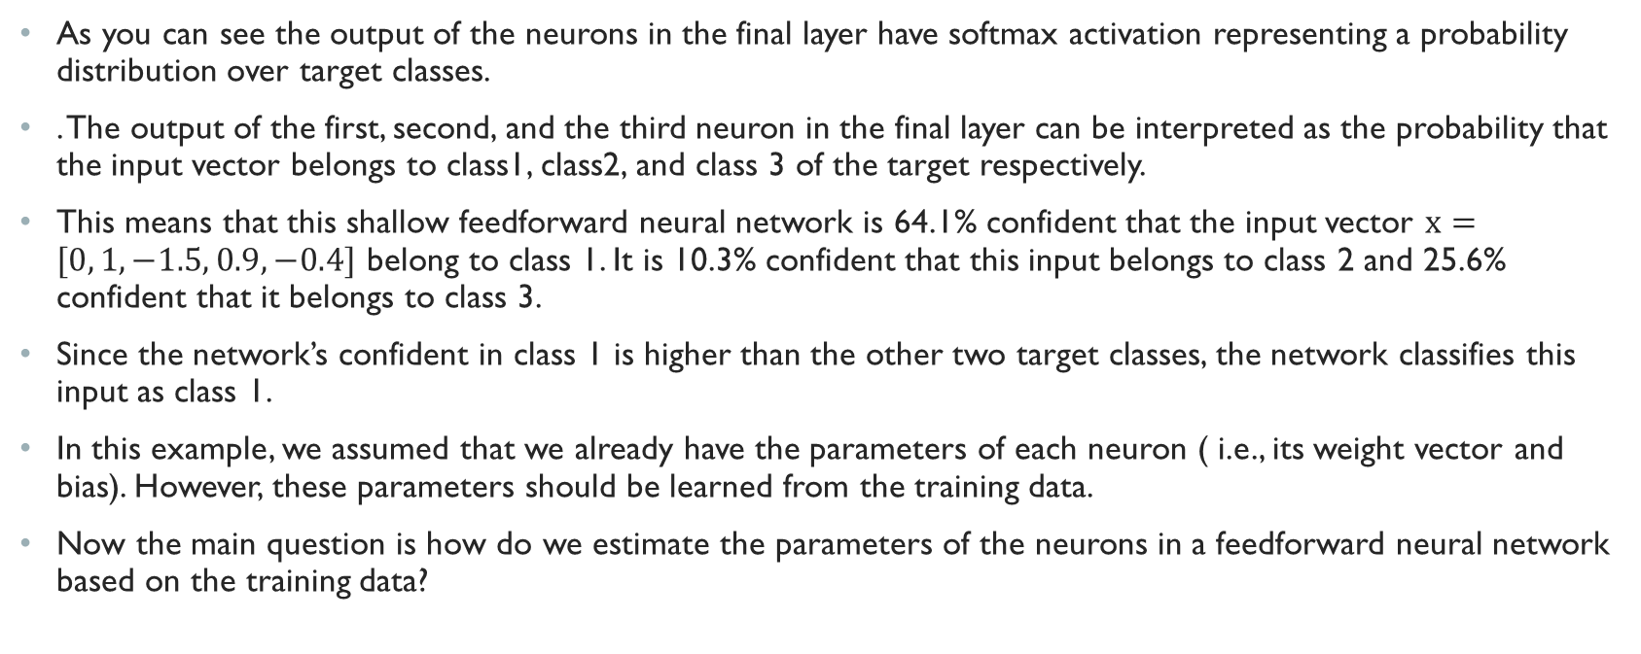
Example of a feedforward neural network (cont.)
As you can see the output of the neurons in the final layer have softmax activation representing a probability distribution over target classes.
. The output of the first, second, and the third neuron in the final layer can be interpreted as the probability that the input vector belongs to class1, class2, and class 3 of the target respectively.
This means that this shallow feedforward neural network is 64.1% confident that the input vector $x=[0, 1,−1.5, 0.9, −0.4]$ belong to class 1. It is 10.3% confident that this input belongs to class 2 and 25.6% confident that it belongs to class 3.
Since the network’s confident in class 1 is higher than the other two target classes, the network classifies this input as class 1.
In this example, we assumed that we already have the parameters of each neuron ( i.e., its weight vector and bias). However, these parameters should be learned from the training data.
Now the main question is how do we estimate the parameters of the neurons in a feedforward neural network based on the training data?

Slide 18
Learning the parameters of a feedforward neural network: The Loss Function

Slide 19
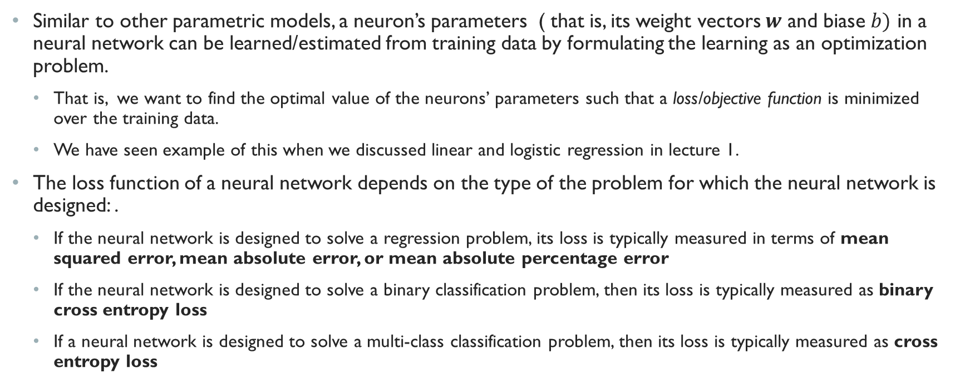
Loss function
Similar to other parametric models, a neuron’s parameters ( that is, its weight vectors $w$ and biase $b)$ in a neural network can be learned/estimated from training data by formulating the learning as an optimization problem.
That is, we want to find the optimal value of the neurons’ parameters such that a loss/objective function is minimized over the training data.
We have seen example of this when we discussed linear and logistic regression in lecture 1.
The loss function of a neural network depends on the type of the problem for which the neural network is designed: .
If the neural network is designed to solve a regression problem, its loss is typically measured in terms of mean squared error, mean absolute error, or mean absolute percentage error
If the neural network is designed to solve a binary classification problem, then its loss is typically measured as binary cross entropy loss
If a neural network is designed to solve a multi-class classification problem, then its loss is typically measured as cross entropy loss

Slide 20
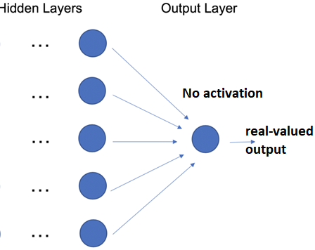
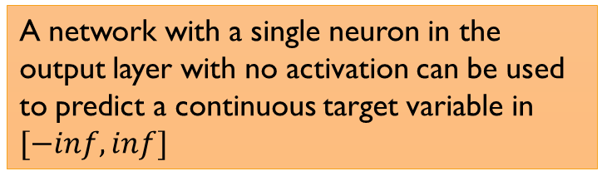
Deep learning for regression
Recall from lecture 1, that in a regression problem we want to predict a real-valued (continuous) target variable.
Many simple regression problems (such as predicting the house price based on some features of the house, or predicting income based on demographic, education, etc. ) are not large or complex enough to require deep learning.
Deep learning regression is appropriate for perceptual problems ( such as predicting the age of a person from the raw image of their face or detecting the coordinate/width/height of the bounding box representing objects in an image).
Deep learning regression might also be used in sequence problems such as financial time series ( for example, forecasting the stock price based on previous days)
Suppose a regression problem in which we want to predict an unbounded continuous target variable. For such regression problem, it might make sense to use a single neuron with no activation in the output layer. This ensures that our network outputs an unbounded real value.
A network with a single neuron in the output layer with no activation can be used to predict a continuous target variable in $[−inf,inf]$

Slide 21
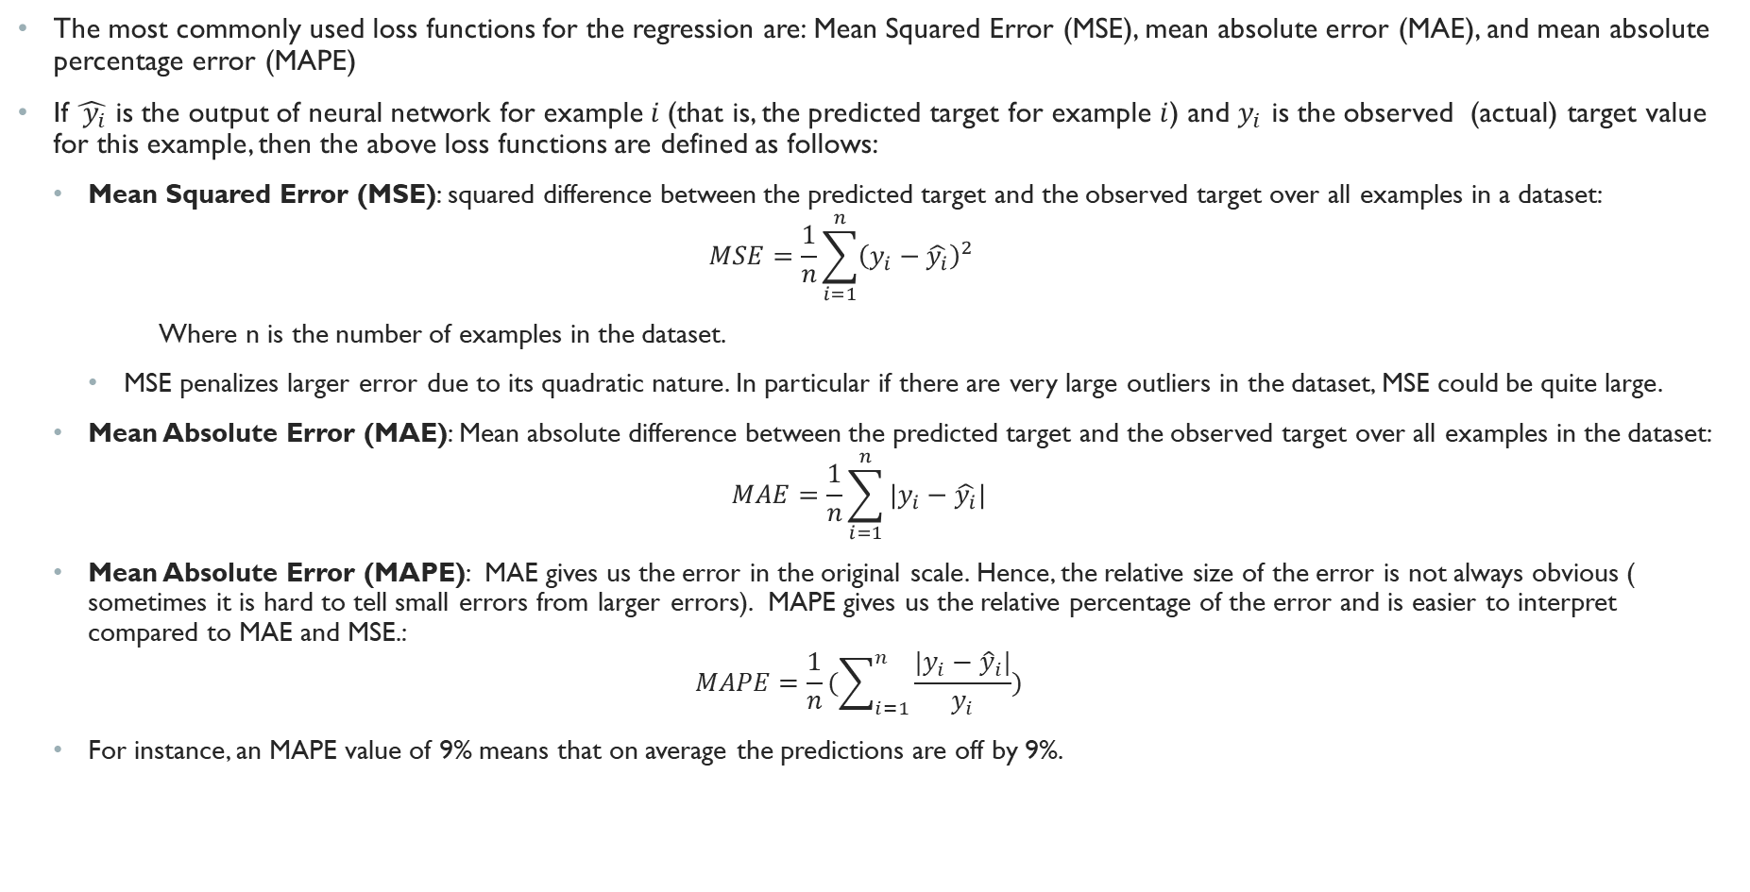
Regression loss function
The most commonly used loss functions for the regression are: Mean Squared Error (MSE), mean absolute error (MAE), and mean absolute percentage error (MAPE)
If $\hat{ y_{i}}$ is the output of neural network for example $i$(that is, the predicted target for example $i$) and $y_{i}$ is the observed (actual) target value for this example, then the above loss functions are defined as follows:
Mean Squared Error (MSE): squared difference between the predicted target and the observed target over all examples in a dataset:
$$MSE=\frac{1}{n}\sum_{i=1}^{n}{{\left(y_{i}−\hat{y_{i}}\right)}^{2}}$$
Where n is the number of examples in the dataset.
MSE penalizes larger error due to its quadratic nature. In particular if there are very large outliers in the dataset, MSE could be quite large.
Mean Absolute Error (MAE): Mean absolute difference between the predicted target and the observed target over all examples in the dataset:
$$MAE=\frac{1}{n}\sum_{i=1}^{n}{|y_{i}−\hat{y_{i}}|}$$
Mean Absolute Error (MAPE): MAE gives us the error in the original scale. Hence, the relative size of the error is not always obvious ( sometimes it is hard to tell small errors from larger errors). MAPE gives us the relative percentage of the error and is easier to interpret compared to MAE and MSE.:
$$MAPE=\frac{1}{n}(\sum_{i=1}^{n}{\frac{|y_{i}−{\hat{y}}_{i}|}{y_{i}}})$$
For instance, an MAPE value of 9% means that on average the predictions are off by 9%.

Slide 22
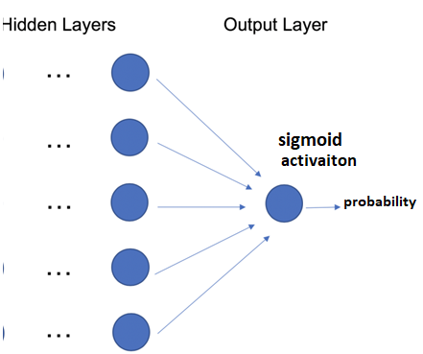
Deep Learning for Binary Classification
A neural network used for binary classification outputs the probability that a given input belongs to one of the two classes.
For instance, a network trained to recognize cats from dogs based on their pictures outputs the probability that a given image is cat vs dog.
A network with a single neuron in the output layer with sigmoid/logistic activation can be used for binary classification to output a value in (0,1) representing probability.

Slide 23
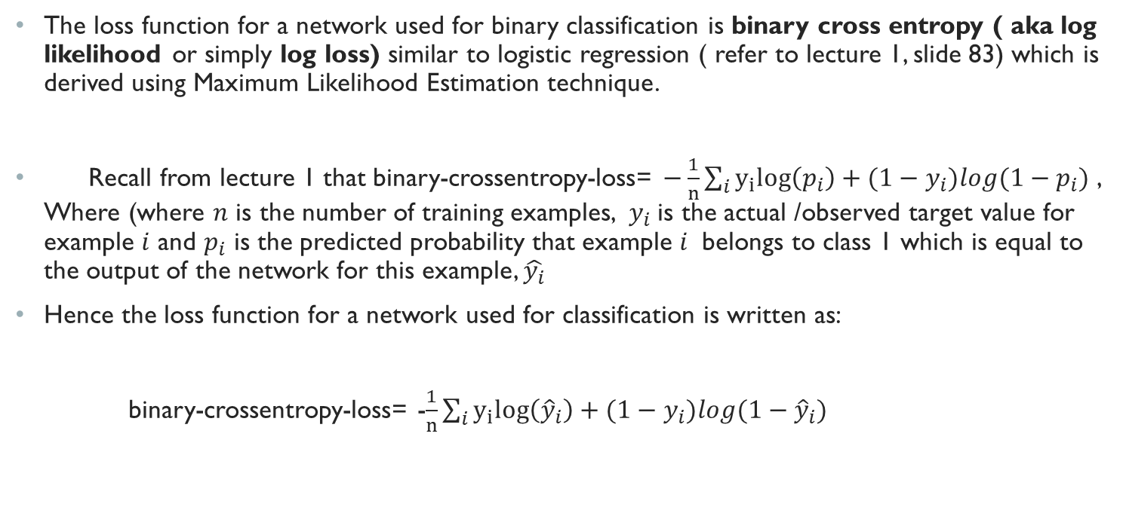
Binary Cross entropy loss
The loss function for a network used for binary classification is binary cross entropy ( aka log likelihood or simply log loss) similar to logistic regression ( refer to lecture 1, slide 83) which is derived using Maximum Likelihood Estimation technique.
Recall from lecture 1 that binary-crossentropy-loss= $−\frac{1}{n}\sum_{i}{y_{i}log\left(p_{i}\right)+{(1−y}_{i})log(1−p_{i})}$ , Where (where $n$ is the number of training examples, $y_{i}$is the actual /observed target value for example $i$ and $p_{i}$ is the predicted probability that example $i$ belongs to class 1 which is equal to the output of the network for this example, $\hat{y_{i}}$
Hence the loss function for a network used for classification is written as:
binary-crossentropy-loss= -$\frac{1}{n}\sum_{i}{y_{i}log\left({\hat{y}}_{i}\right)+{(1−y}_{i})log(1−{\hat{y}}_{i})}$

Slide 24
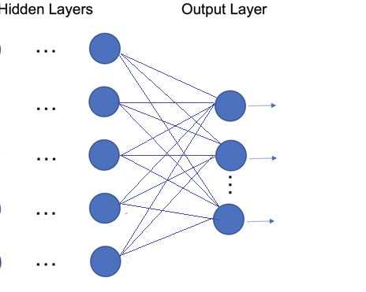



Deep Learning for multiclass Classification
In a multi-class classification problem when the target classes are mutually exclusive, we want the output of the network to be a probability distribution over target class.
A network with k neurons with softmax activation in the final layer ( where k is the number of target classes) can be used for a multi-class classification problem to output a probability distribution over target classes.
Softmax activation
$${\hat{y}}_{1}$$
$${\hat{y}}_{2}$$
Probability
distribution
$${\hat{y}}_{k}$$

Slide 25
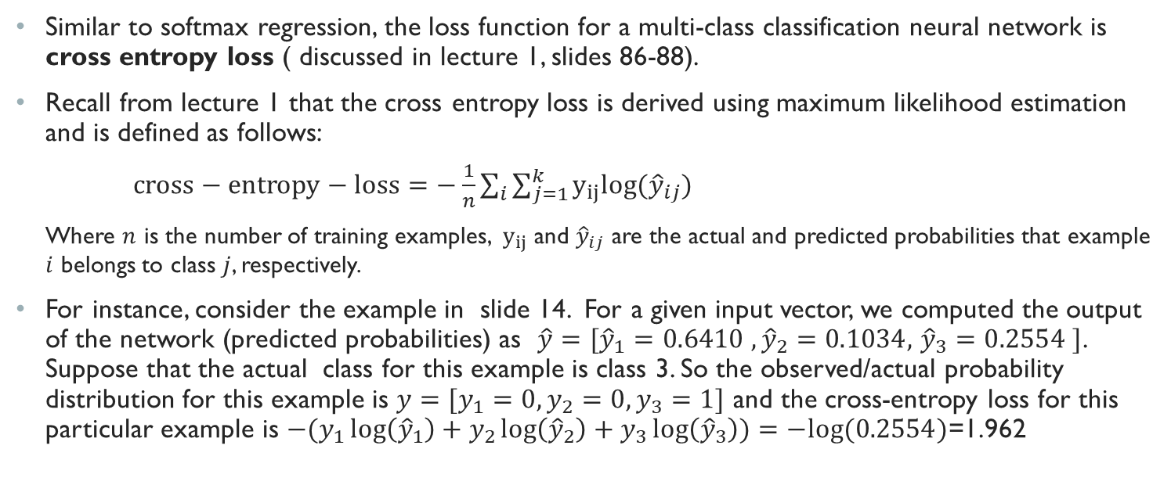
Cross Entropy Loss
Similar to softmax regression, the loss function for a multi-class classification neural network is cross entropy loss ( discussed in lecture 1, slides 86-88).
Recall from lecture 1 that the cross entropy loss is derived using maximum likelihood estimation and is defined as follows:
$cross−entropy−loss=−\frac{1}{n}\sum_{i}{\sum_{j=1}^{k}{y_{ij}log⁡({\hat{y}}_{ij})}}$
Where $n$ is the number of training examples, $y_{ij}$ and ${\hat{y}}_{ij}$ are the actual and predicted probabilities that example $i$ belongs to class $j$, respectively.
For instance, consider the example in slide 14. For a given input vector, we computed the output of the network (predicted probabilities) as $\hat{y}=[{\hat{y}}_{1}=0.6410 ,{\hat{y}}_{2}=0.1034,$ ${\hat{y}}_{3}=0.2554 ]$. Suppose that the actual class for this example is class 3. So the observed/actual probability distribution for this example is $y=[y_{1}=0, y_{2}=0, y_{3}=1]$ and the cross-entropy loss for this particular example is ${−(y}_{1}\log\left({\hat{y}}_{1}\right)+y_{2}\log\left({\hat{y}}_{2}\right)+y_{3}\log\left({\hat{y}}_{3}\right))=−log⁡(0.2554)$=1.962

